Slide 1

Chicago
Wednesday, December 10, 2014
3:30 p.m.
Champaign
Tuesday, December 16, 2014
10:30 a.m.

Slide 2
Introduction
It is my great pleasure to talk to you about the remarkable story of ATG®.
This is our 50th Anniversary – a good time to reflect on where we’ve been, where we are, and where we are going.

Slide 3
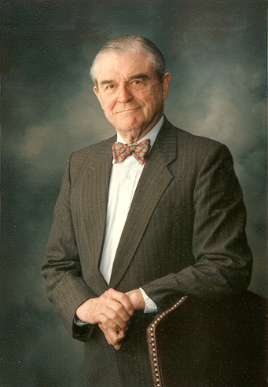
History
We were founded in 1964 by a small group of downstate lawyers led by Stan Balbach.
Back then, lawyers were starting to get pushed out of representing clients in the sale or purchase of a home.

Slide 4
History
Both then and today, the sale or purchase of a home represents the largest transaction of most consumers’ lives. It is a stressful, complex, and baffling process. Consumers need an advocate to navigate the real estate transaction, which is for them uncharted waters.

Slide 5
History
Title companies and Realtors® said:
“Don’t bother with a lawyer. We can do everything. Our title insurance will protect you. We can do the documents and closing and the Realtor will do the negotiations, the contract, and work with the bank.”

Slide 6
History
That small group of lawyers had a vision:
If the lawyers joined together and formed a title insurance company, the lawyers would have a weapon to fight back against the title companies and Realtors.
If they were successful in building a “Guaranty Fund,” lawyers could continue to represent consumers by complimenting their legal services with title services.
The best of both worlds!

Slide 7
History
Our Original Mission was:
To preserve the role of the lawyer in real estate transactions for the public.

Slide 8
History
Over the years, ATG has consistently defied all odds – succeeding in even the most challenging times.
The Early Days | 1964-1970
Gaining Momentum | 1970-1985
Organic Growth Despite Bruising Competition and No Debt | 1985-1995
Diversification | 1995-2005
Emergence as a Leader | 2005-Present

Slide 9

50th Anniversary
This year we celebrated our 50th Anniversary.

Slide 10
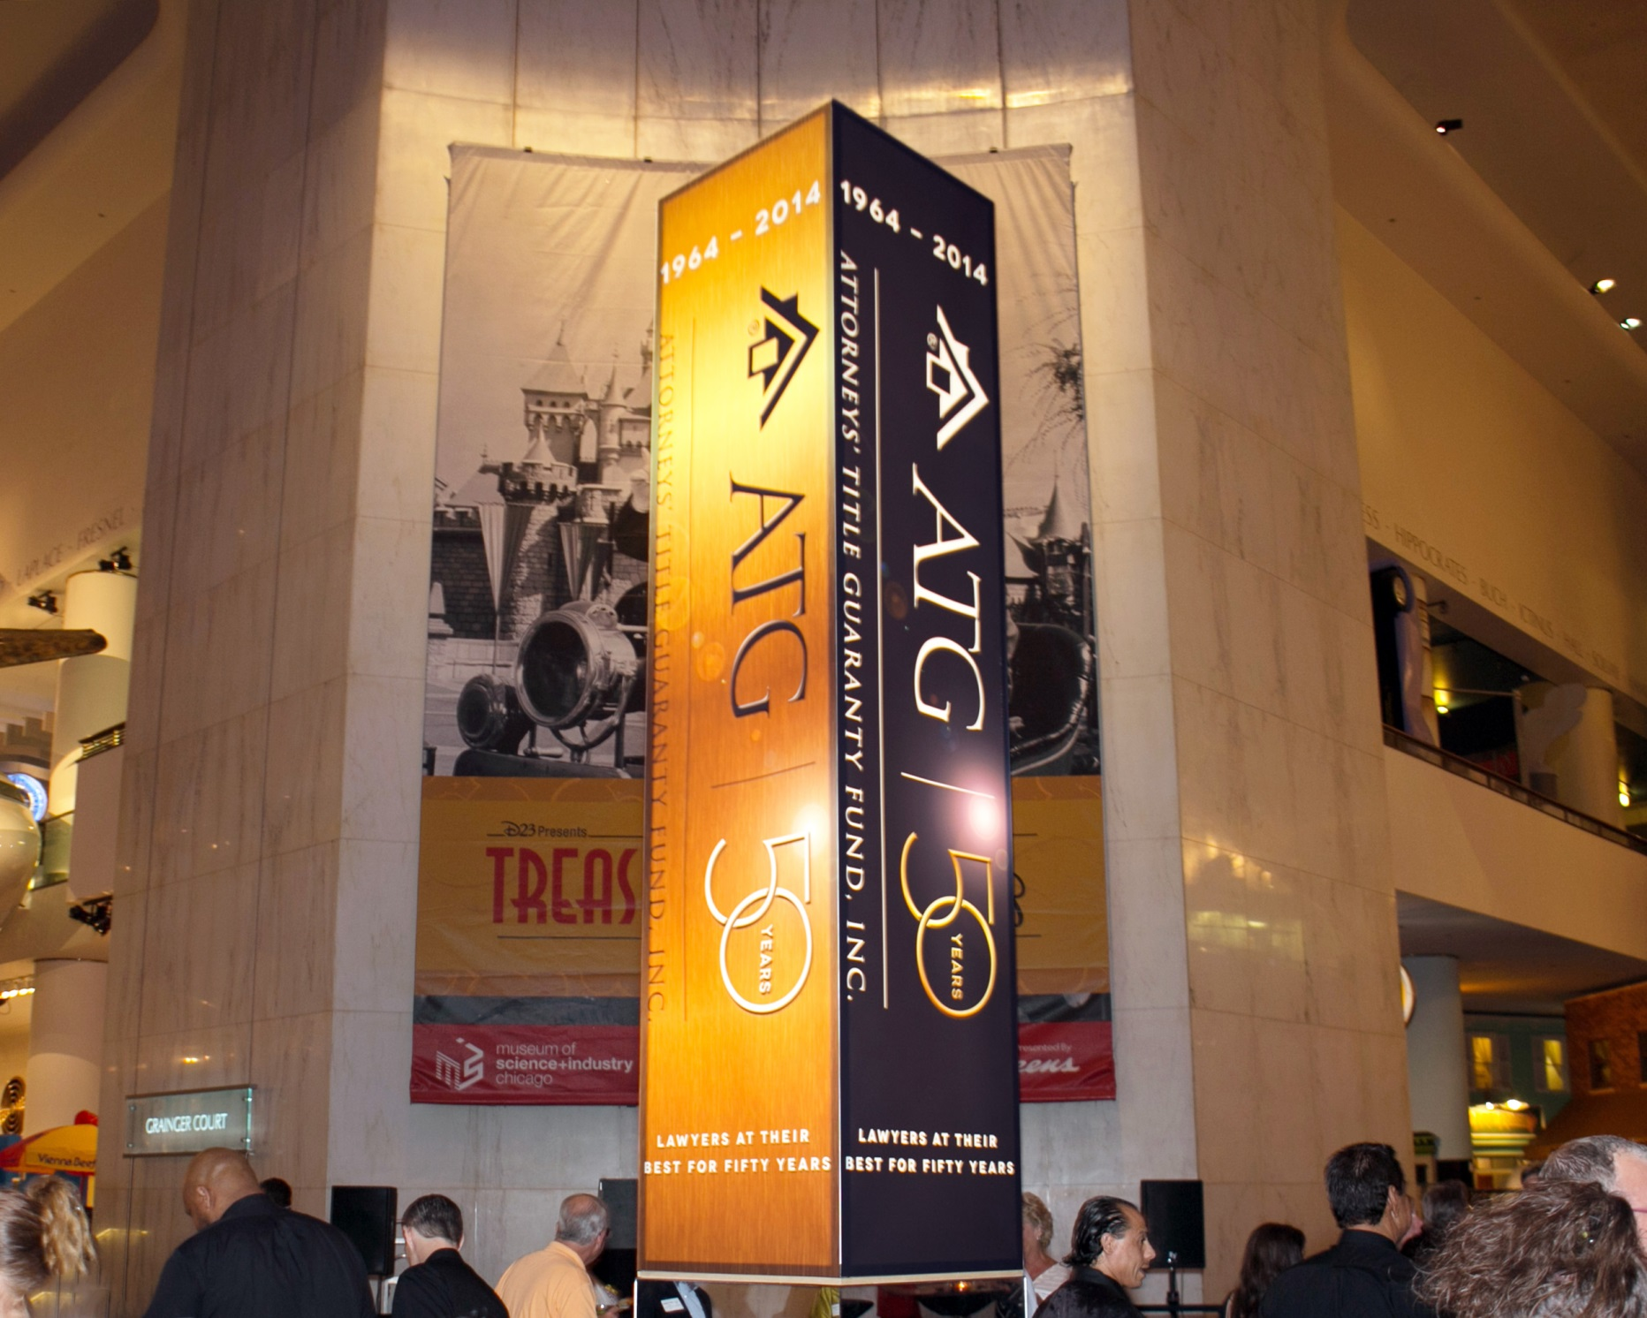

Slide 11
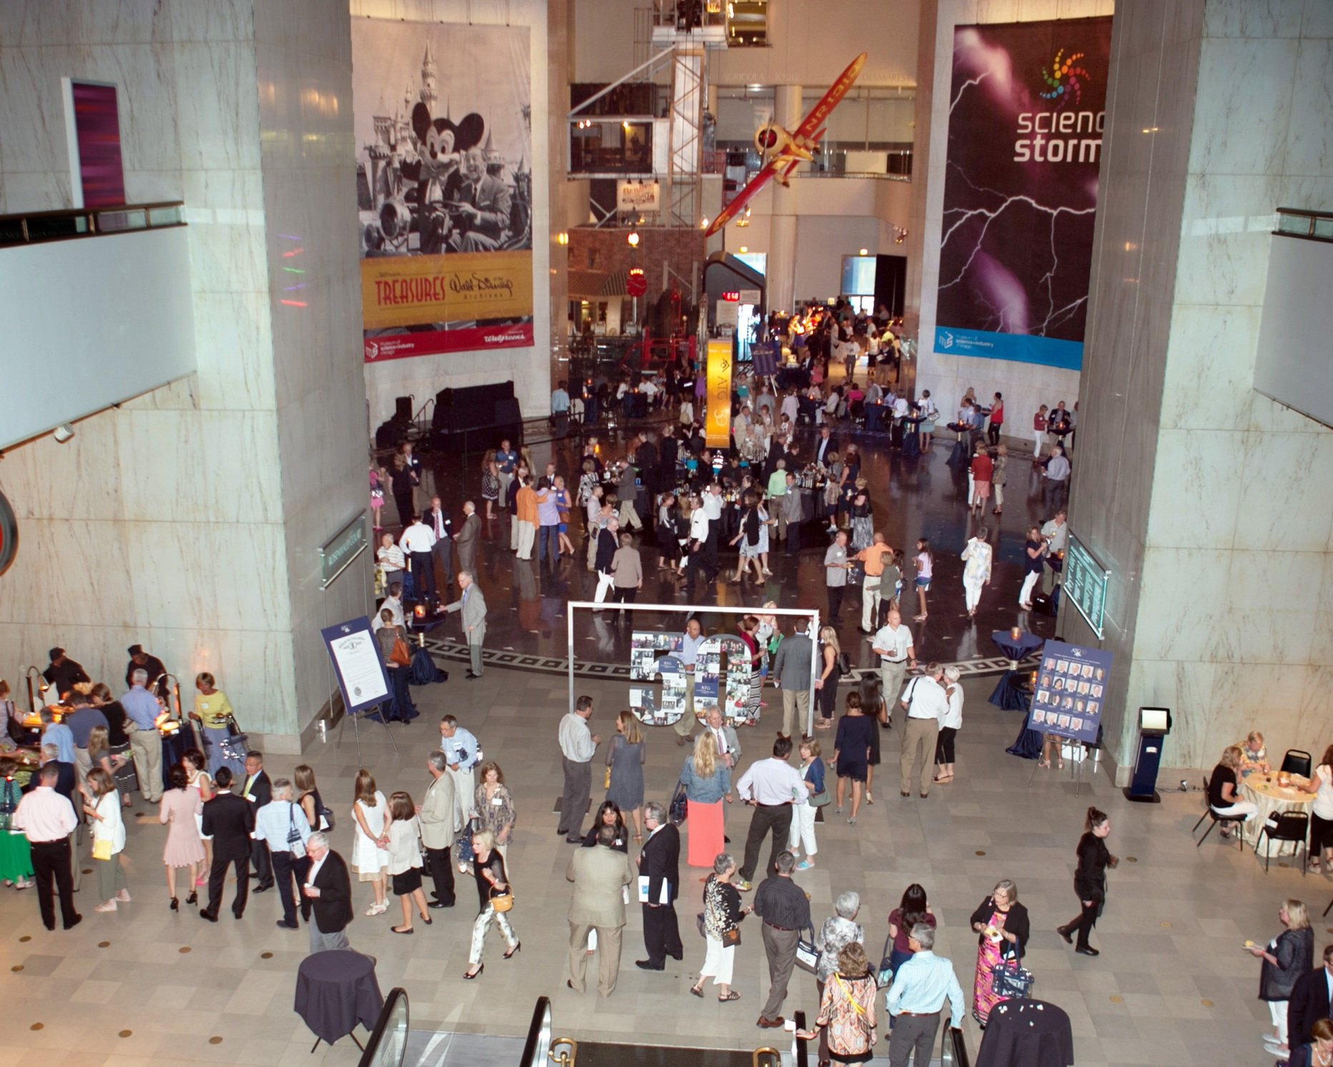

Slide 12
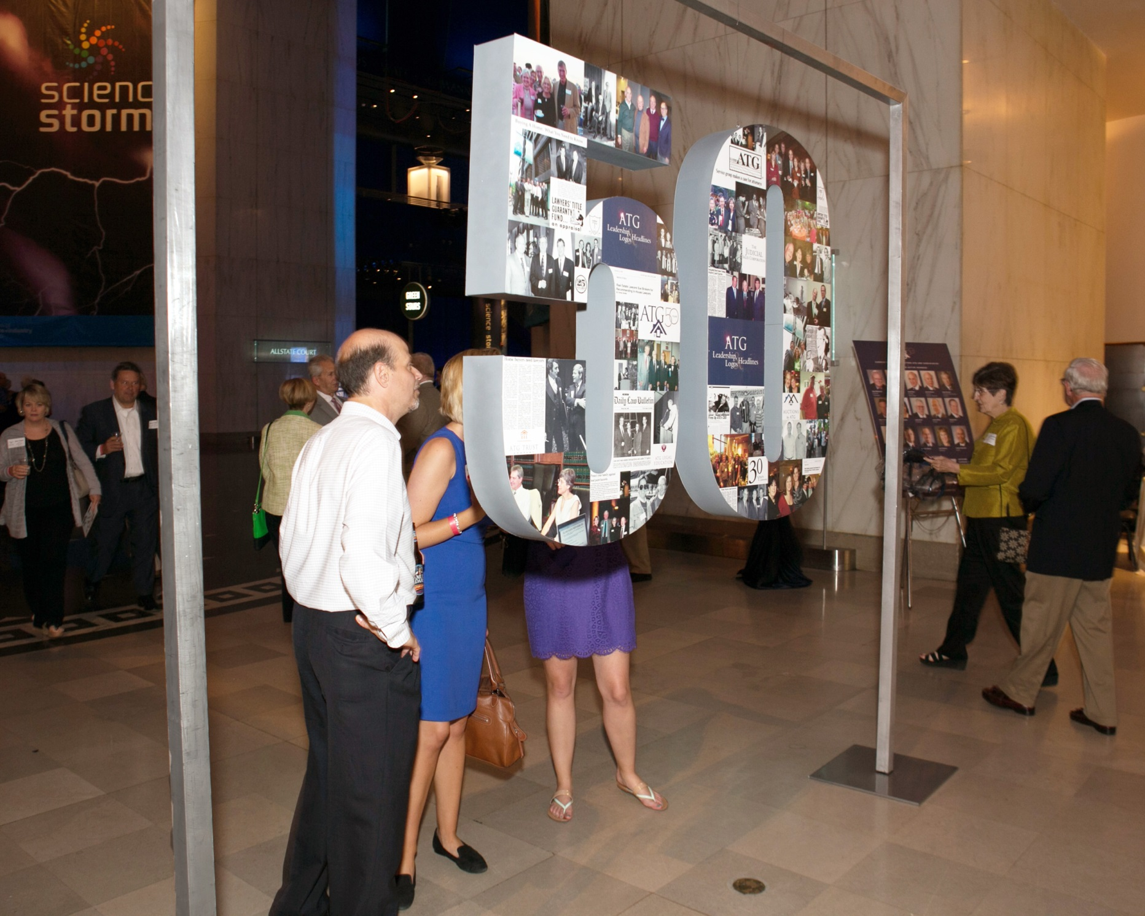

Slide 13


Slide 14


Slide 15
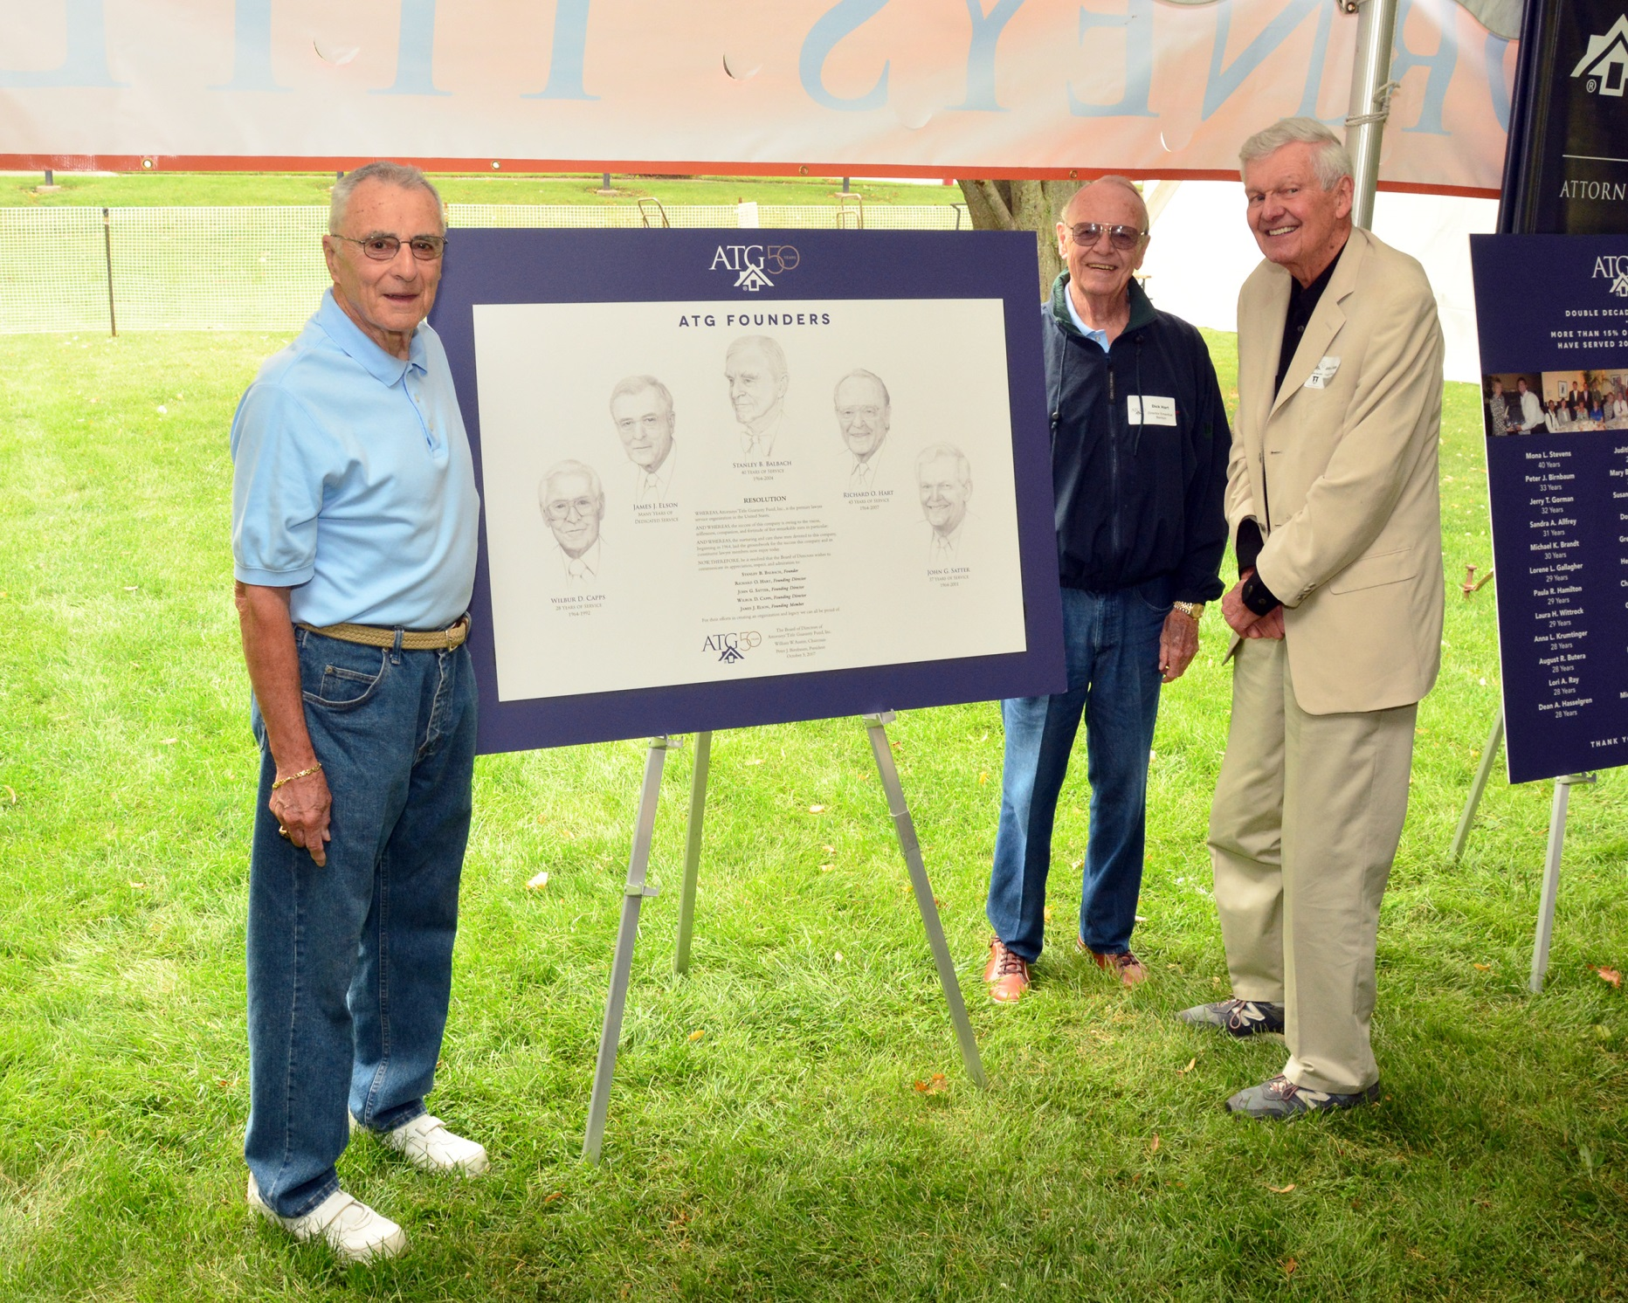

Slide 16
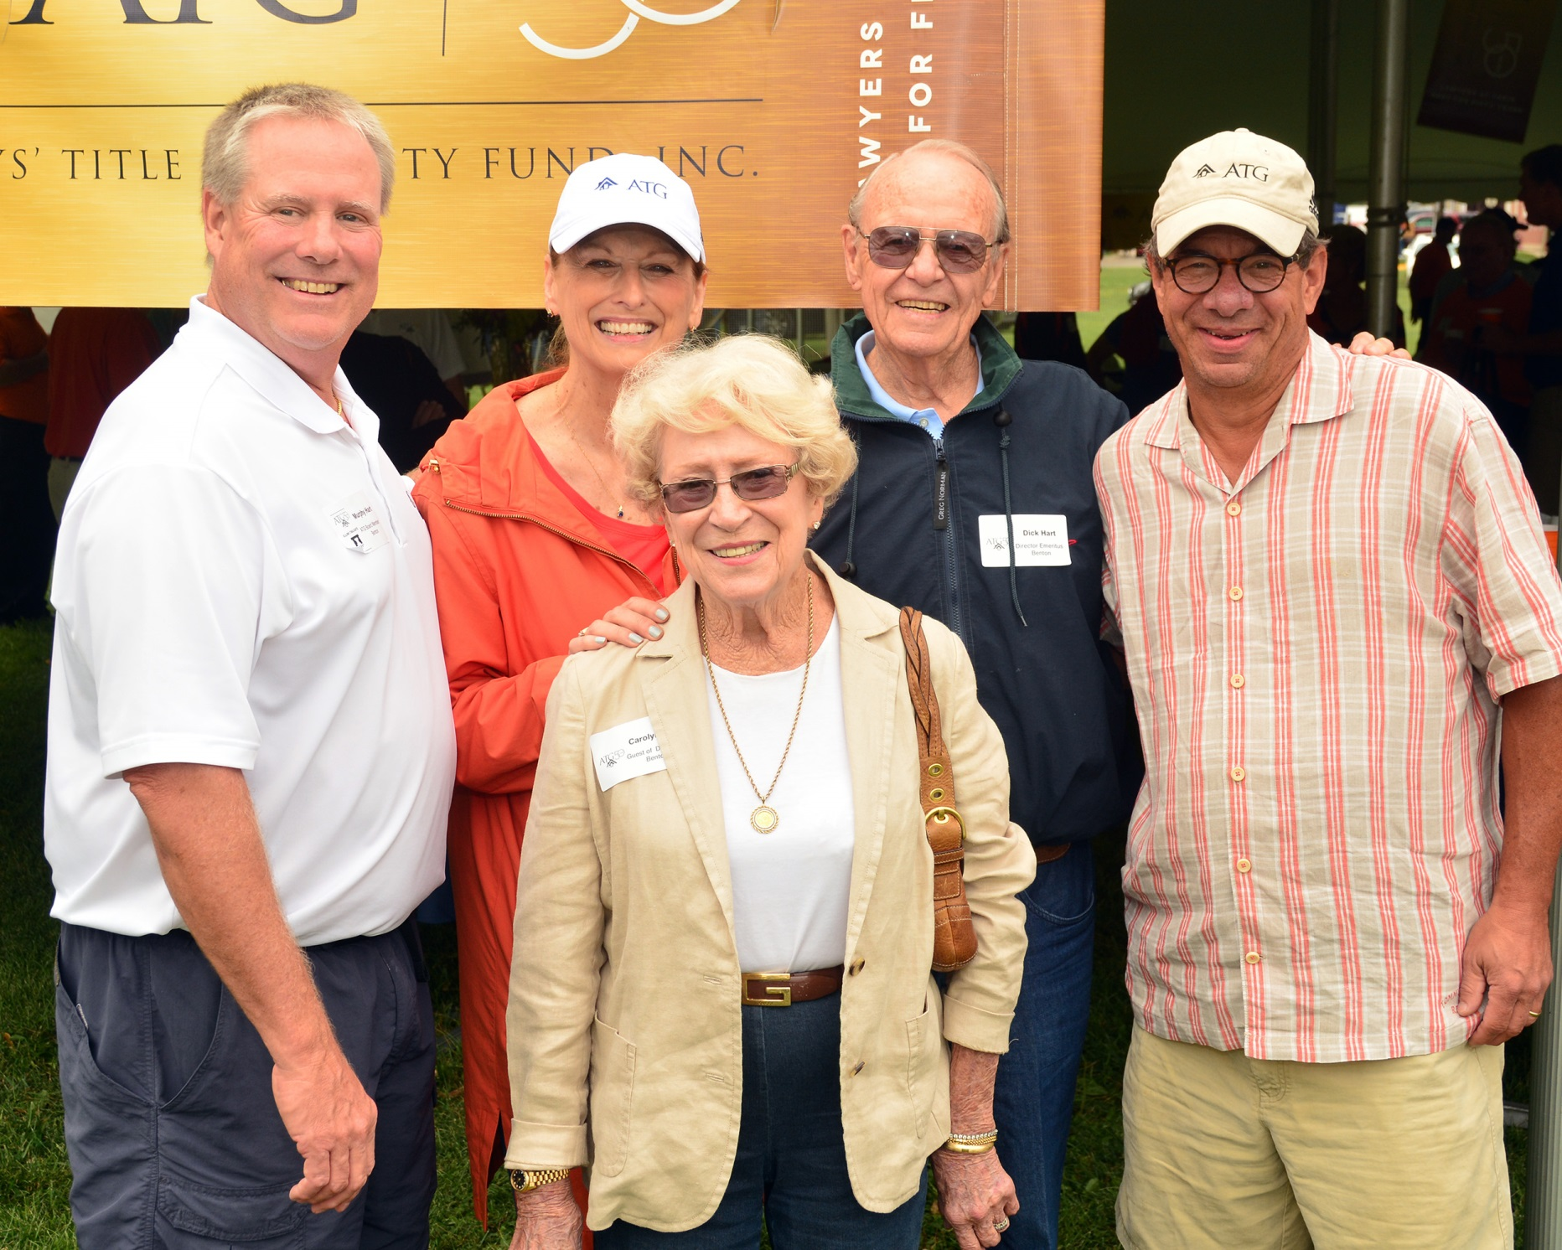

Slide 17
2014 Highlights
Financials
3 Millionth Policy
Member Services
Subsidiary and Product Growth
Advocacy
Leadership
Service to the Community

Slide 18
Financials
Revenue History (1964-2014)

Slide 19
Financials
Profits (2001-2014) in thousands of Dollars

Slide 20
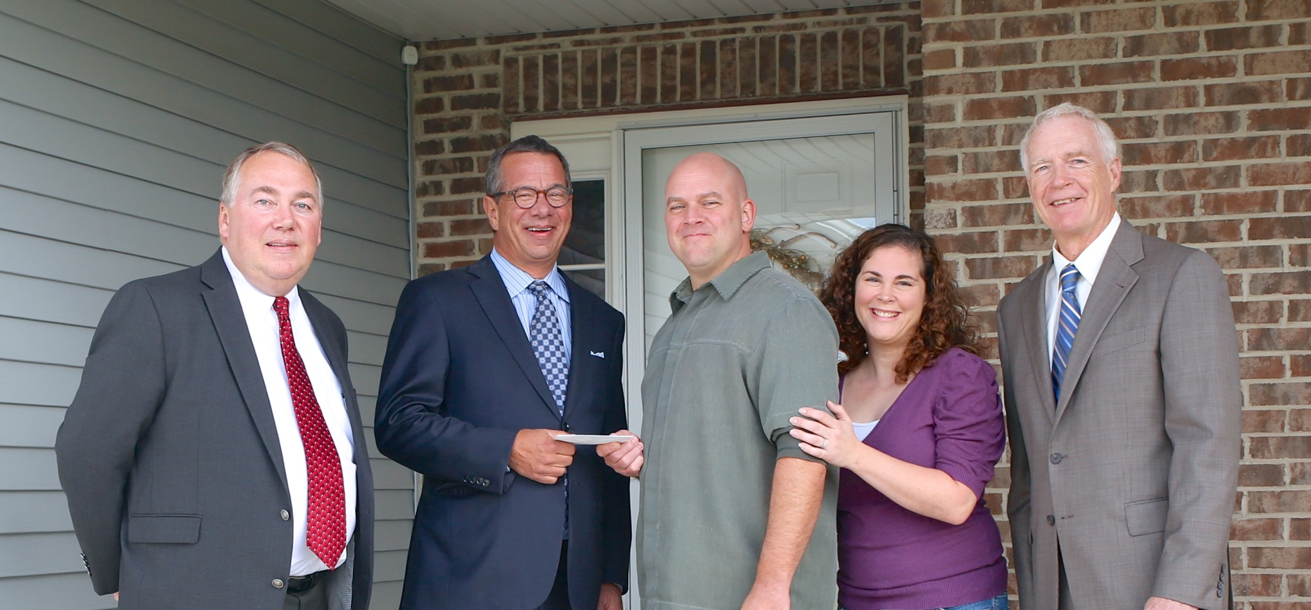
3 Millionth Policy

Slide 21
Member Services
Technology
Audit, Training, and Education
Closing Services
Title Services
Search Services
Lead-up to Best Practices and RESPA TILA.

Slide 22
Subsidiary and Product Growth
Our Mission Today Reflects the Diversity of our Products
Our mission is to be the premier lawyer service organization for the benefit of the profession and the public.

Slide 23
Subsidiary and Product Growth
A Diverse Array of Products and Services
Cyclical;
Counter-Cyclical; and
Cyclically Neutral.

Slide 24

Subsidiaries

Slide 25
Advocacy
ISBA
ALTA
ILTA
Government
Courts

Slide 26
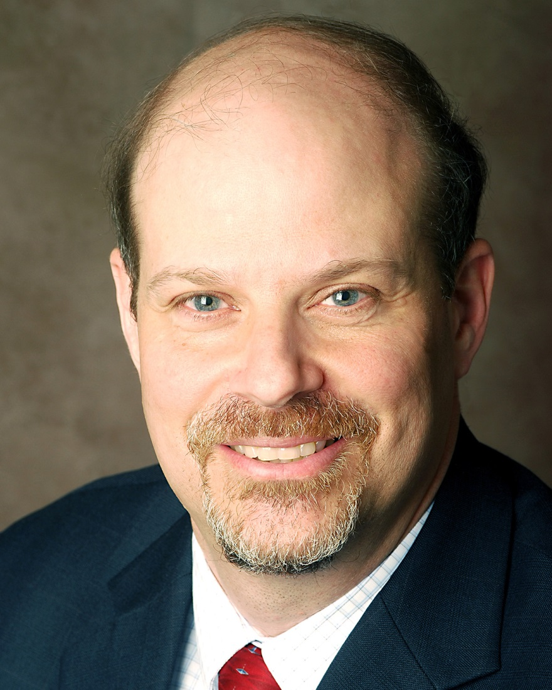
Leadership
ILTA Past President
Augie Butera

Slide 27
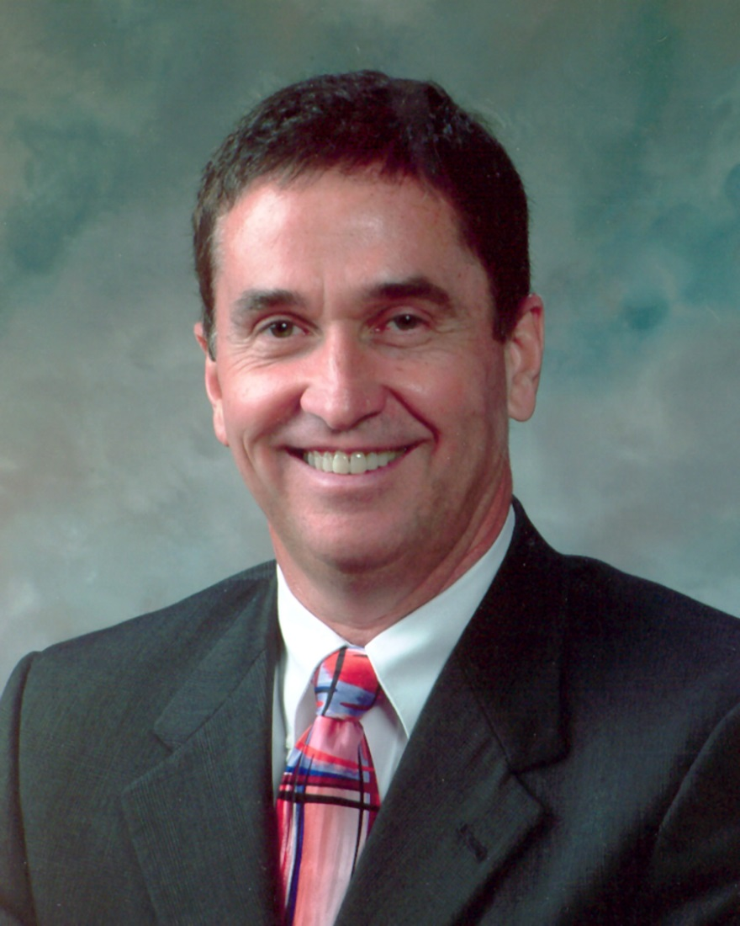
Leadership
ILTA Past President
Mike Brandt

Slide 28
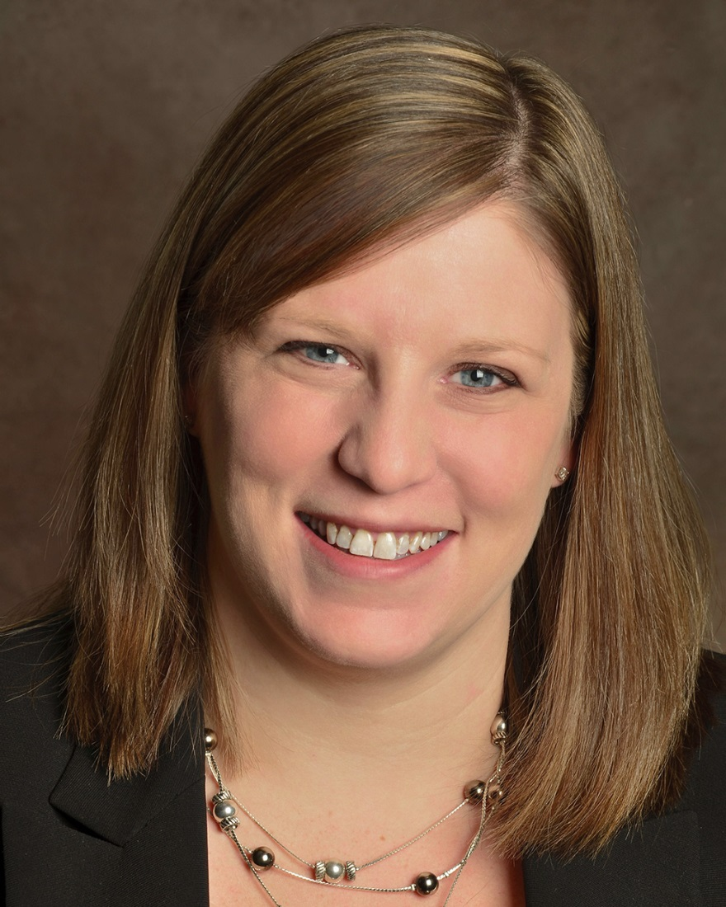
Leadership
ILTA Incoming President
Christine Sparks

Slide 29
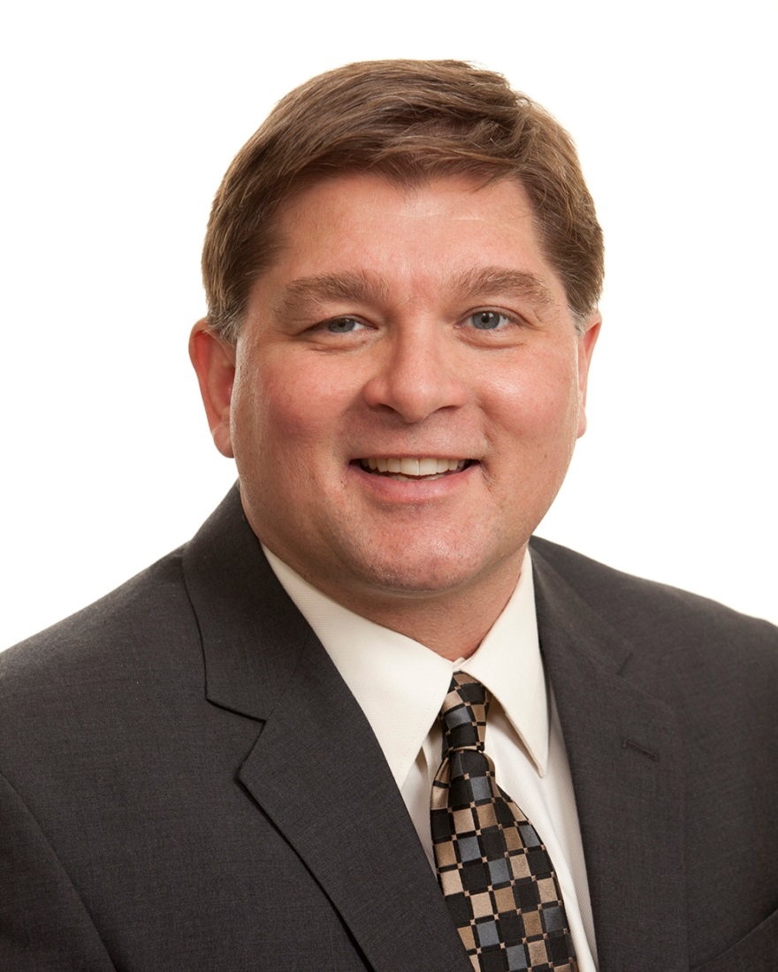
Leadership
WLTA President
Tom Cullen

Slide 30
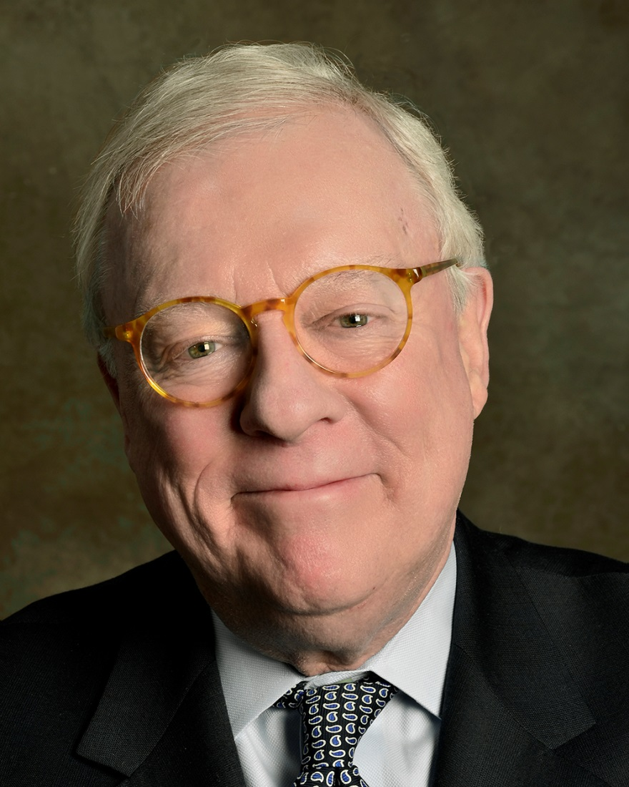
Leadership
ISBA Past President
IRELA Founder and Past President
John O’Brien

Slide 31
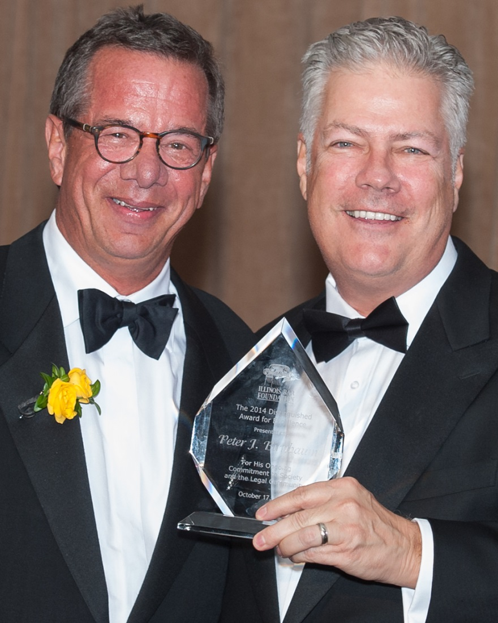
Leadership
Illinois Bar Foundation 2014 Distinguished Award of Excellence
Peter Birnbaum
ALTA Board of Governors

Slide 32
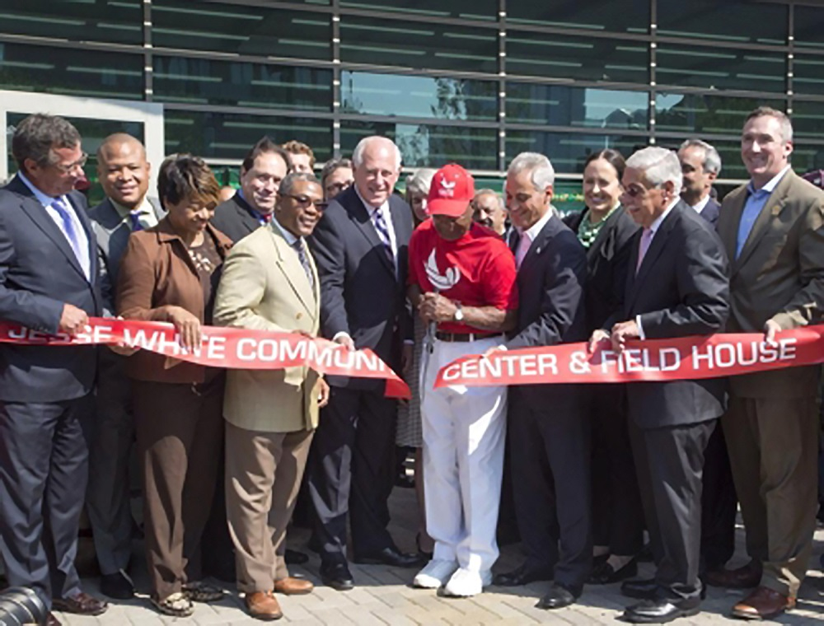
Service to the Community
The Jesse White Foundation
Cara Program
Big Brothers Big Sisters of Metropolitan Chicago
Neighborhood Housing
Mercy Housing
Cubs Charities
Mercy Home
University of Illinois Law School
Mikva Challenge
And Many Others!

Slide 33
What Drives Our Success?

Slide 34
Collaboration and Shared Vision
A loyal and dedicated membership.
A Board that is 100% committed to our mission through strategic planning.
A knowledgeable, long-tenured, and energetic staff.
Ability to react quickly.
A collective vision and a spirit of camaraderie, working toward a common goal.

Slide 35
Metrics of Success
Financial Strength
Financial Ratings
Member Support
Corporate Citizenry
Leadership
Stewardship

Slide 36
Challenges
We still have many challenges.
What are the big issues?

Slide 37
Marketplace Issues
RESPA/TILA
ALTA Best Practices/Lender Liability for Third Party Vendors
Controlled Business
Unauthorized Practice of Law (UPL)
Mortgage and Housing Market

Slide 38
Regulatory and Marketplace Shifts that Drive Fundamental Changes in our Industry
The Housing and Financial Crisis of 2007
Consumer Financial Protection Bureau (CFPB)
Bank Liability
ALTA Best Practices
Vendor Supervision

Slide 39
Competition
“Race to the Bottom”
The Battle for Control of the Transaction

Slide 40
Service
Customer-Driven
Doing the Right Thing
Listen
Lead
Technology
Training
Messaging

Slide 41
Mortgage Market
The Future of the Government-Sponsored Enterprises (GSEs)
The Big Five Banks
What That Means to Us

Slide 42
Advocacy
ALTA
ILTA
Bar Associations
Supreme Court
Legislature
Regulators

Slide 43
Expanded Product Mix – Building for the Future
ATG Trust Company
The Judicial Sales Corporation
New Partnership with Auction.com
ATG LegalServe, Inc.
ATG Legal Education
NLT Title, LLC
Auctions by ATG
New Markets
Why That is Important

Slide 44
Looking Forward
There are challenges, but the opportunities are incredible.

Slide 45
Best Practices/Bank Supervision
Because of Best Practices and Bank Vendor Supervision, our support system will change dramatically.
Now, more than ever, we need to give our members the tools they need to compete. Our members look to us for leadership.

Slide 46
Opportunities
We will be on the forefront of delivering competitive tools to our members.
We will preserve the future of the small law firm and title agent. This will distinguish us in the market.
We will expand our brand, geography, and product mix.

Slide 47
Opportunities
We will work for our constituents:
with ALTA, Congress, the Courts, Regulators, Legislature, the banks, and Media to give consumers access to top-quality legal services.

Slide 48
Our fiftieth year has been a year of celebration, reflection, and most importantly, looking to the future.

Slide 49
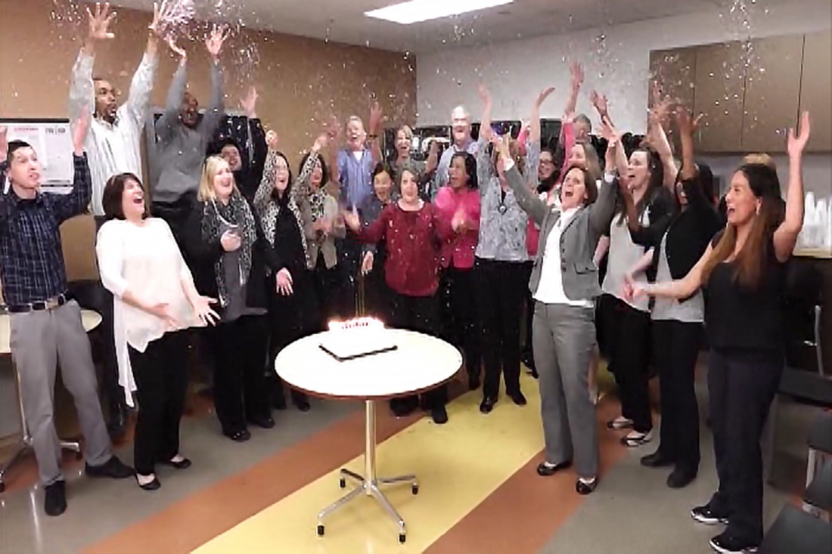

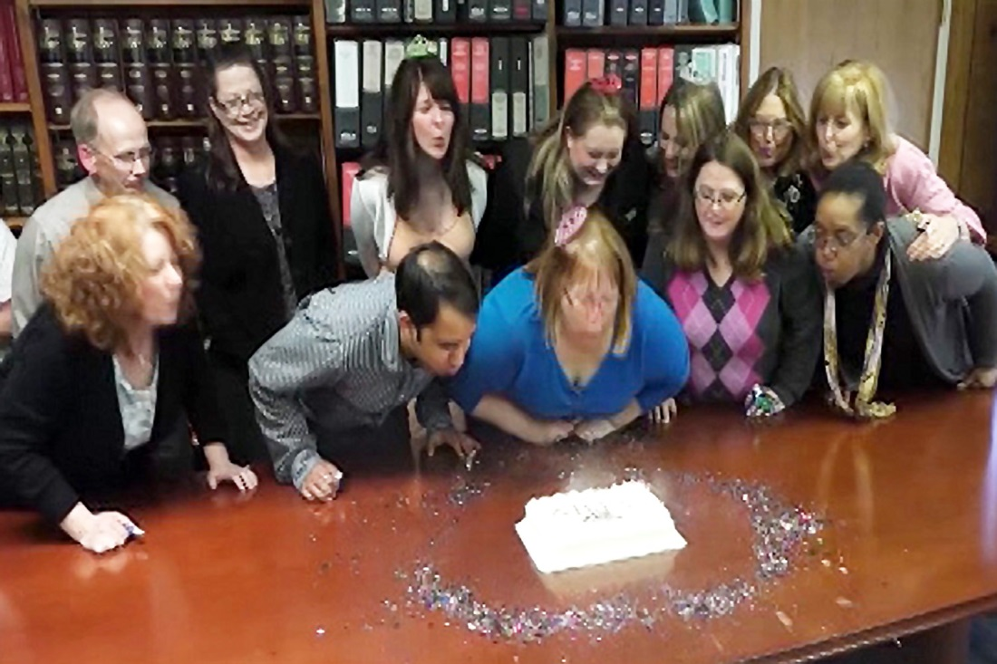
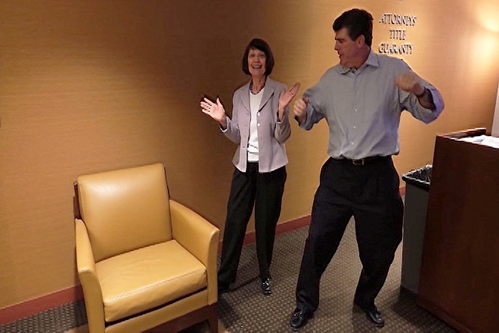
When we celebrate our success, we celebrate You!

Slide 50


